Slide 1
Segmentation
CSCI 4150/6050: Computer Vision

Slide 2
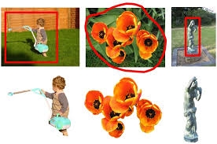
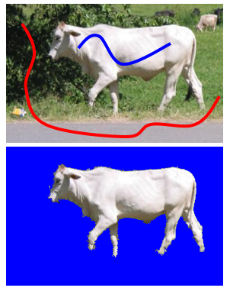
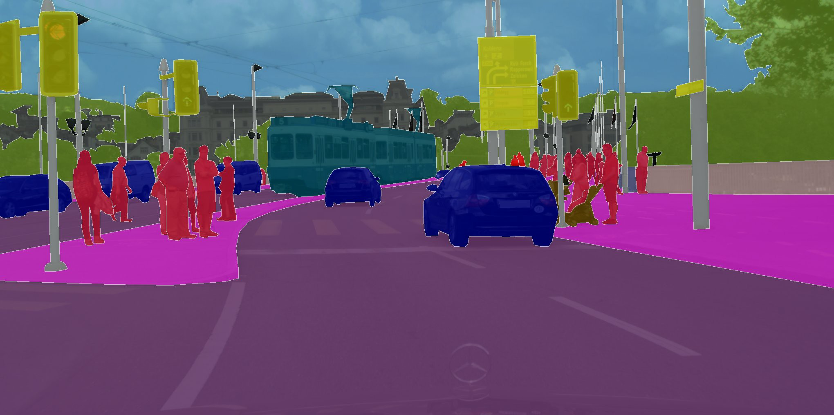
Segmentation
Segmentation is the partitioning of an image or video into different regions
These regions ideally correspond to objects
Variations:
  Supervised vs. unsupervised
  Binary: foreground vs. background
  Multiple objects / complete partitioning
  Semantic

Slide 3
Region-Based
Core idea: group pixels based on common properties (“affinity”)
  Color
  Texture
  Motion
  and lots of other properties …

Slide 4
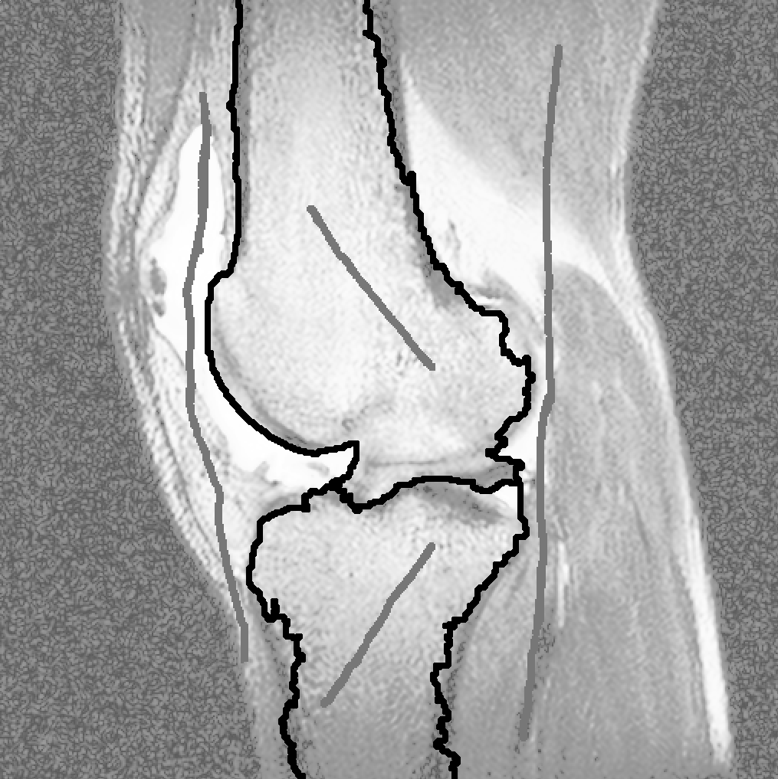
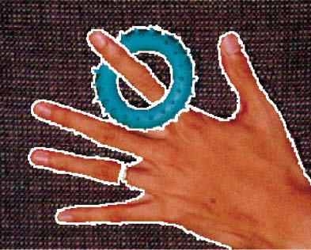
Region-Based
Supervised:
  Region Growing
  Distance-based approaches
  Random walks
  Graph cuts
Unsupervised:
  Gradient watersheds
  Graph spectral approaches
  Clustering
  (including mean-shift clustering)

Slide 5
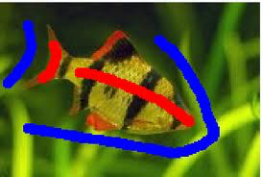
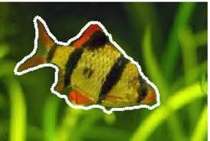
Supervised Segmentation
Core idea: start with some set of pixels known to be in the object(s) / background
Two key things you can learn from them:
  Appearance
  Spatial proximity
Use these properties to segment the rest
Basis for most interactive segmentation tools:
  Place initial seed pixels
  Segment and display results
  Allow user to place other “corrective” seeds
  Resegment and update
  Repeat…

Slide 6
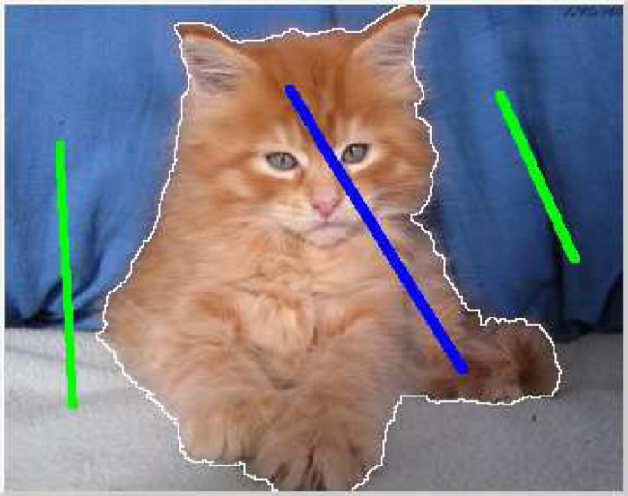
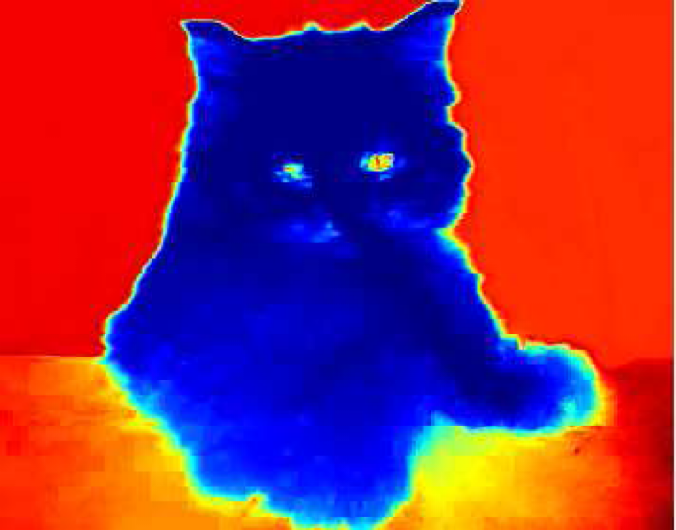
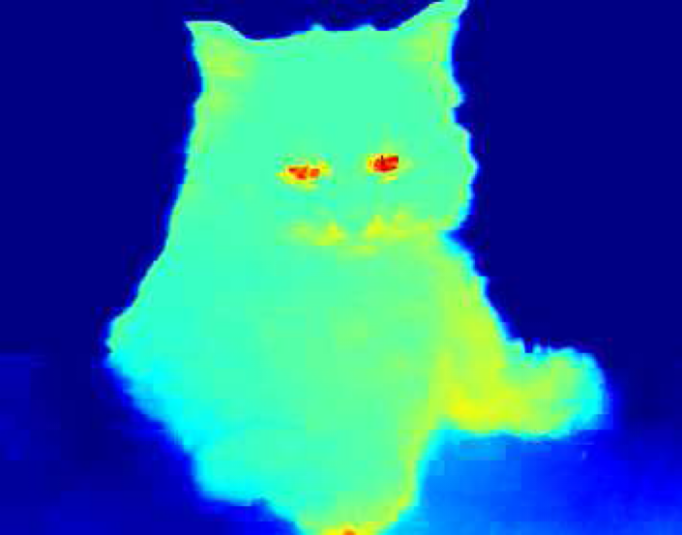
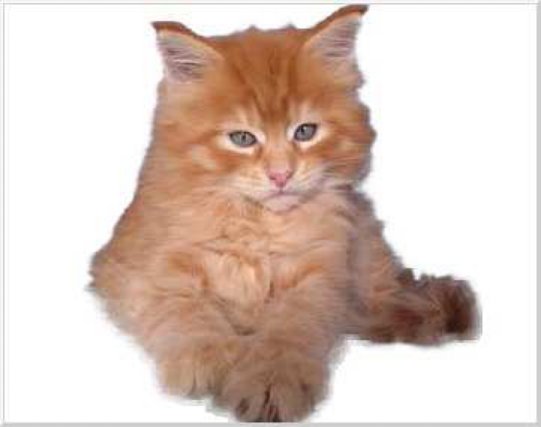
Distance-Based Approaches
Define “distance” between pixels non-uniformly
  Typically based on color/property differences
Use both foreground and background seeds
  Expand outward from foreground seeds
  Expand outward from background seeds
Assign pixels to whichever “distance” is lowest

Slide 7
Example: Geodesic Segmentation
The term “geodesic distance” refers to the shortest distance between two points
Geodesic Segmentation (Bai & Sapiro, 2007):
  Use KDE to build foreground/background color distributions from seeds
  Penalize large transitions in the probability
  Expand outward from seeds to build distance maps
  Assign to whichever seeds are “closer”
Can use wavefront expansion (like Dijkstra) and compute distance maps in O(n) time

Slide 8
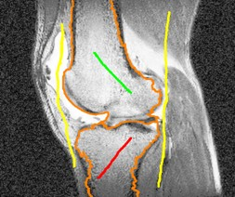
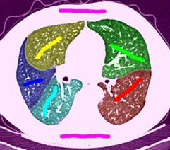
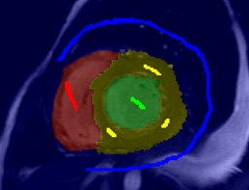
Random Walks
Again use KDE to estimate fg/bg pdfs
Define the probability of transitioning from
one pixel to another based on the pdfs
Starting at a pixel, do a “random walk” by probabilistically transitioning from pixel to pixel
What is the probability over all such walks that you’d find fg seeds? bg seeds?
Can be computed analytically and does not require simulation

Slide 9
Graph-Cut Segmentation
Instead of finding a minimum-cost path
find a minimum-cost cut
Bayesian-like cost function:
  Likelihood: labeled pixels should look like the seeds for their region
  Prior: similar neighbors should go in
  similar regions (smoothness)
Can frame minimization of objective function as the minimum-cost cut through a graph
(known low-degree polynomial-time solutions)

Slide 10

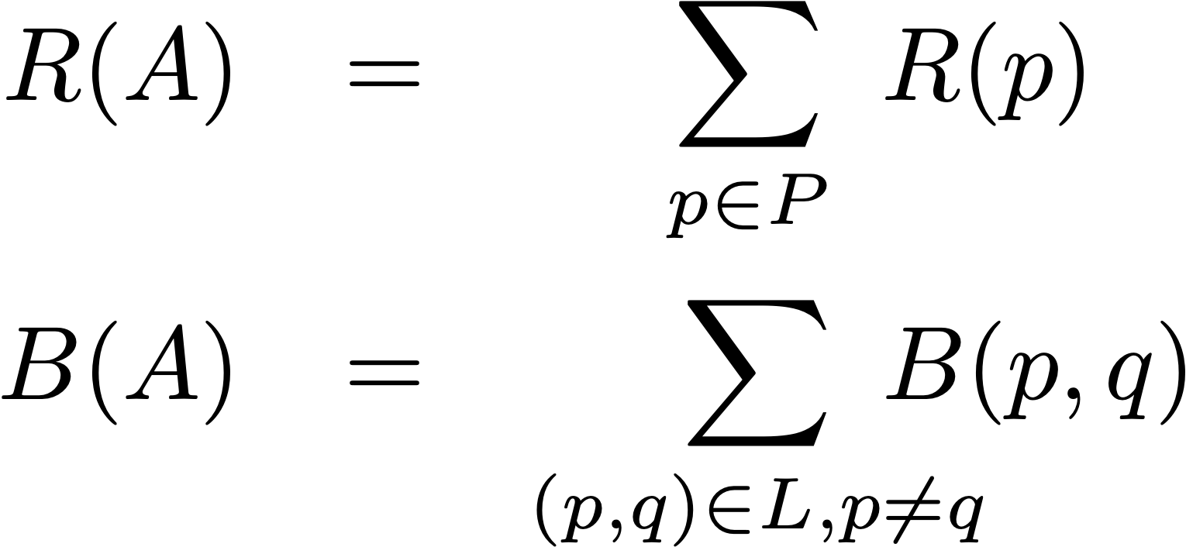
Graph-Cut Segmentation
Let
  P = set of all image pixels
  L = set of links between neighbors
  A = a vector of binary pixel labels
Minimize objective function E(A):
  Region term penalizes labeling pixels that don’t look like the seeds
  Boundary term penalizes labeling similar neighbors with different labels

Slide 11
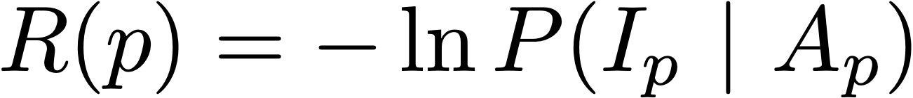
Region Term
Use user-specified seed pixels as examples of the colors in the foreground / background
One way is to use the negative log-likelihood of pixels from the seeded regions looking like the pixel p
Can use other forms, but the key is to penalize labeling pixels as part of a region when they don’t look like the seeds for that region
By itself, this is just a per-pixel classifier based on color and the foreground/background distributions estimated from the seeds
(usually kernel-density estimation)
Can use any form of per-pixel classifier!

Slide 12
Region Term
How do you get this probability distribution?
Most common approach: use the seed pixel colors and kernel-density estimation
By itself, this is just a per-pixel classifier based on color and the foreground/background distributions estimated from the seeds

Slide 13
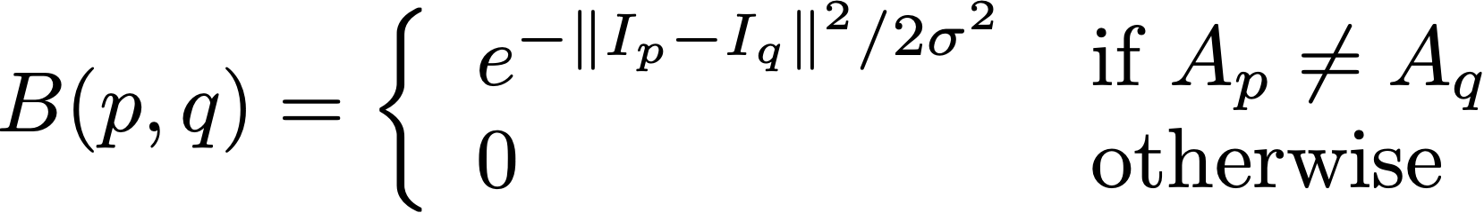
Boundary Term
Pixel-classification alone can be “spotty” due to misses and false positives
Penalize labeling adjacent similar pixels with different labels
Most common: use a monotonically decreasing function of the difference between the two pixels’ colors
This is basically a smoothness prior

Slide 14
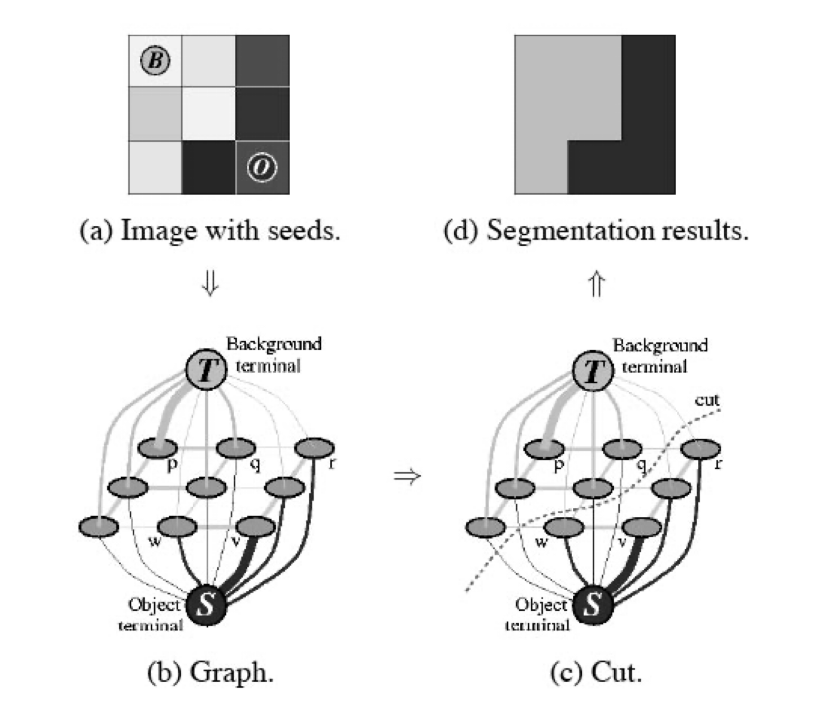
Optimization as Graph Cuts
Nodes (graph vertices):
  One node for each pixel
  Additional terminal node for each region
Links (graph edges or arcs):
  Between neighboring pixels (“n-links”)
  Between terminals and every pixel (“t-links”)
Cost to cut n-link is based on pixel similarity B(p,q)
(intuition: cutting n-link is assigning different labels)
Cost to cut t-link is based on swapped R(p)
(intuition: cutting a t-link is not applying that label)
Find the minimum-cost cut separating terminal nodes
(figure from Boykov & Jolly, ICCV 2001)

Slide 15
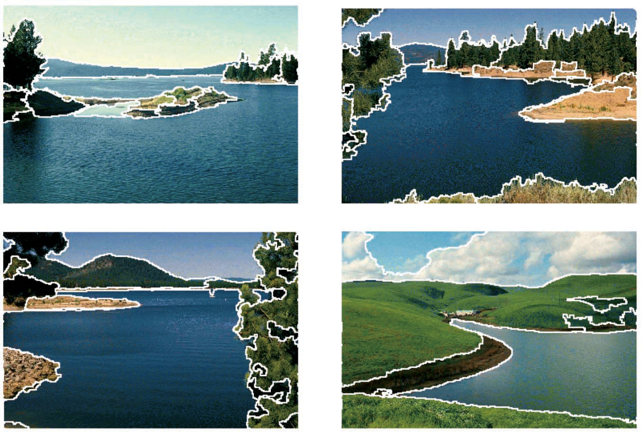
Unsupervised Segmentation
Unsupervised segmentation does not require user interaction or any prior indication of target regions
Partition the image into coherent regions
More recent variant:
  Find “salient” objects of interest
  Segment those
  Don’t worry about otherwise complete partitioning (“background”)

Slide 16
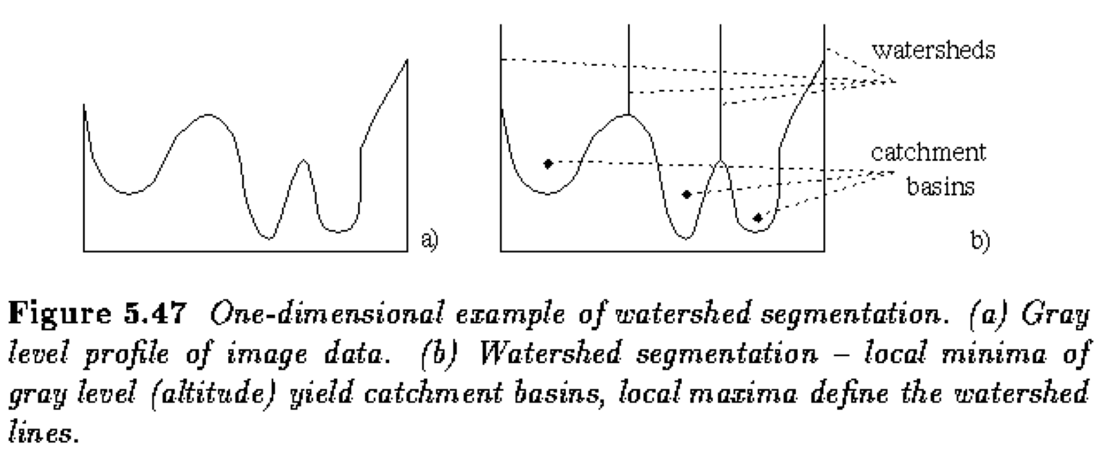
Gradient Watersheds
A “watershed” or “catchment basis” is a region over which all water flows downhill to a common destination
Example: continental divide of the U.S.
Core idea of watershed segmentation:
  Build a gradient-magnitude image
  Compute watershed regions
  (lots of efficient algorithms)
Can smooth the original/gradient image first to reduce noise / produce larger regions

Slide 17
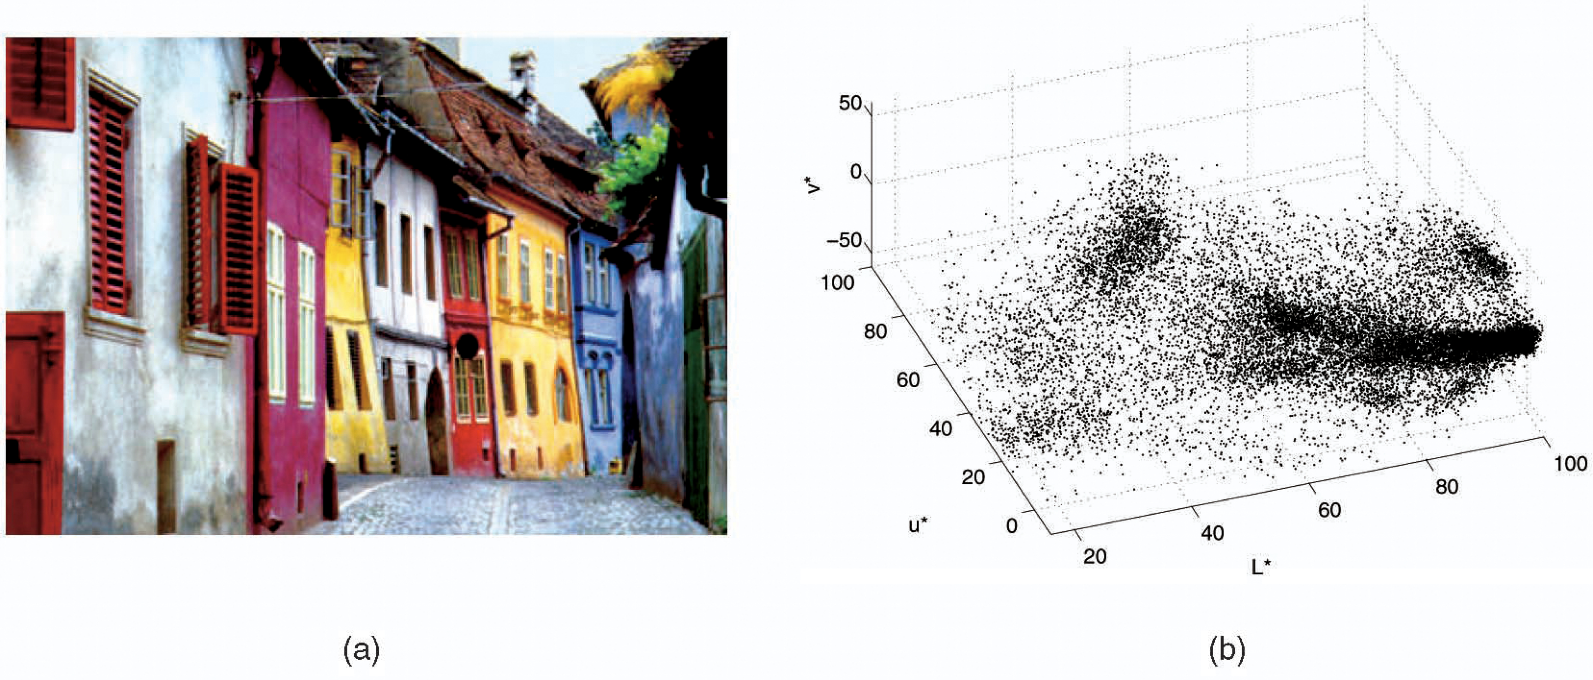
Unsupervised Segmentation as Clustering
Basic idea: unsupervised segmentation is really a form of clustering pixels
Consider the pixels as points in color space and cluster
Problem: clustering in color space alone doesn’t consider spatial aspects
Solution: cluster in 5-dimensional space:
  Color (3)
  Spatial position (2)

Slide 18
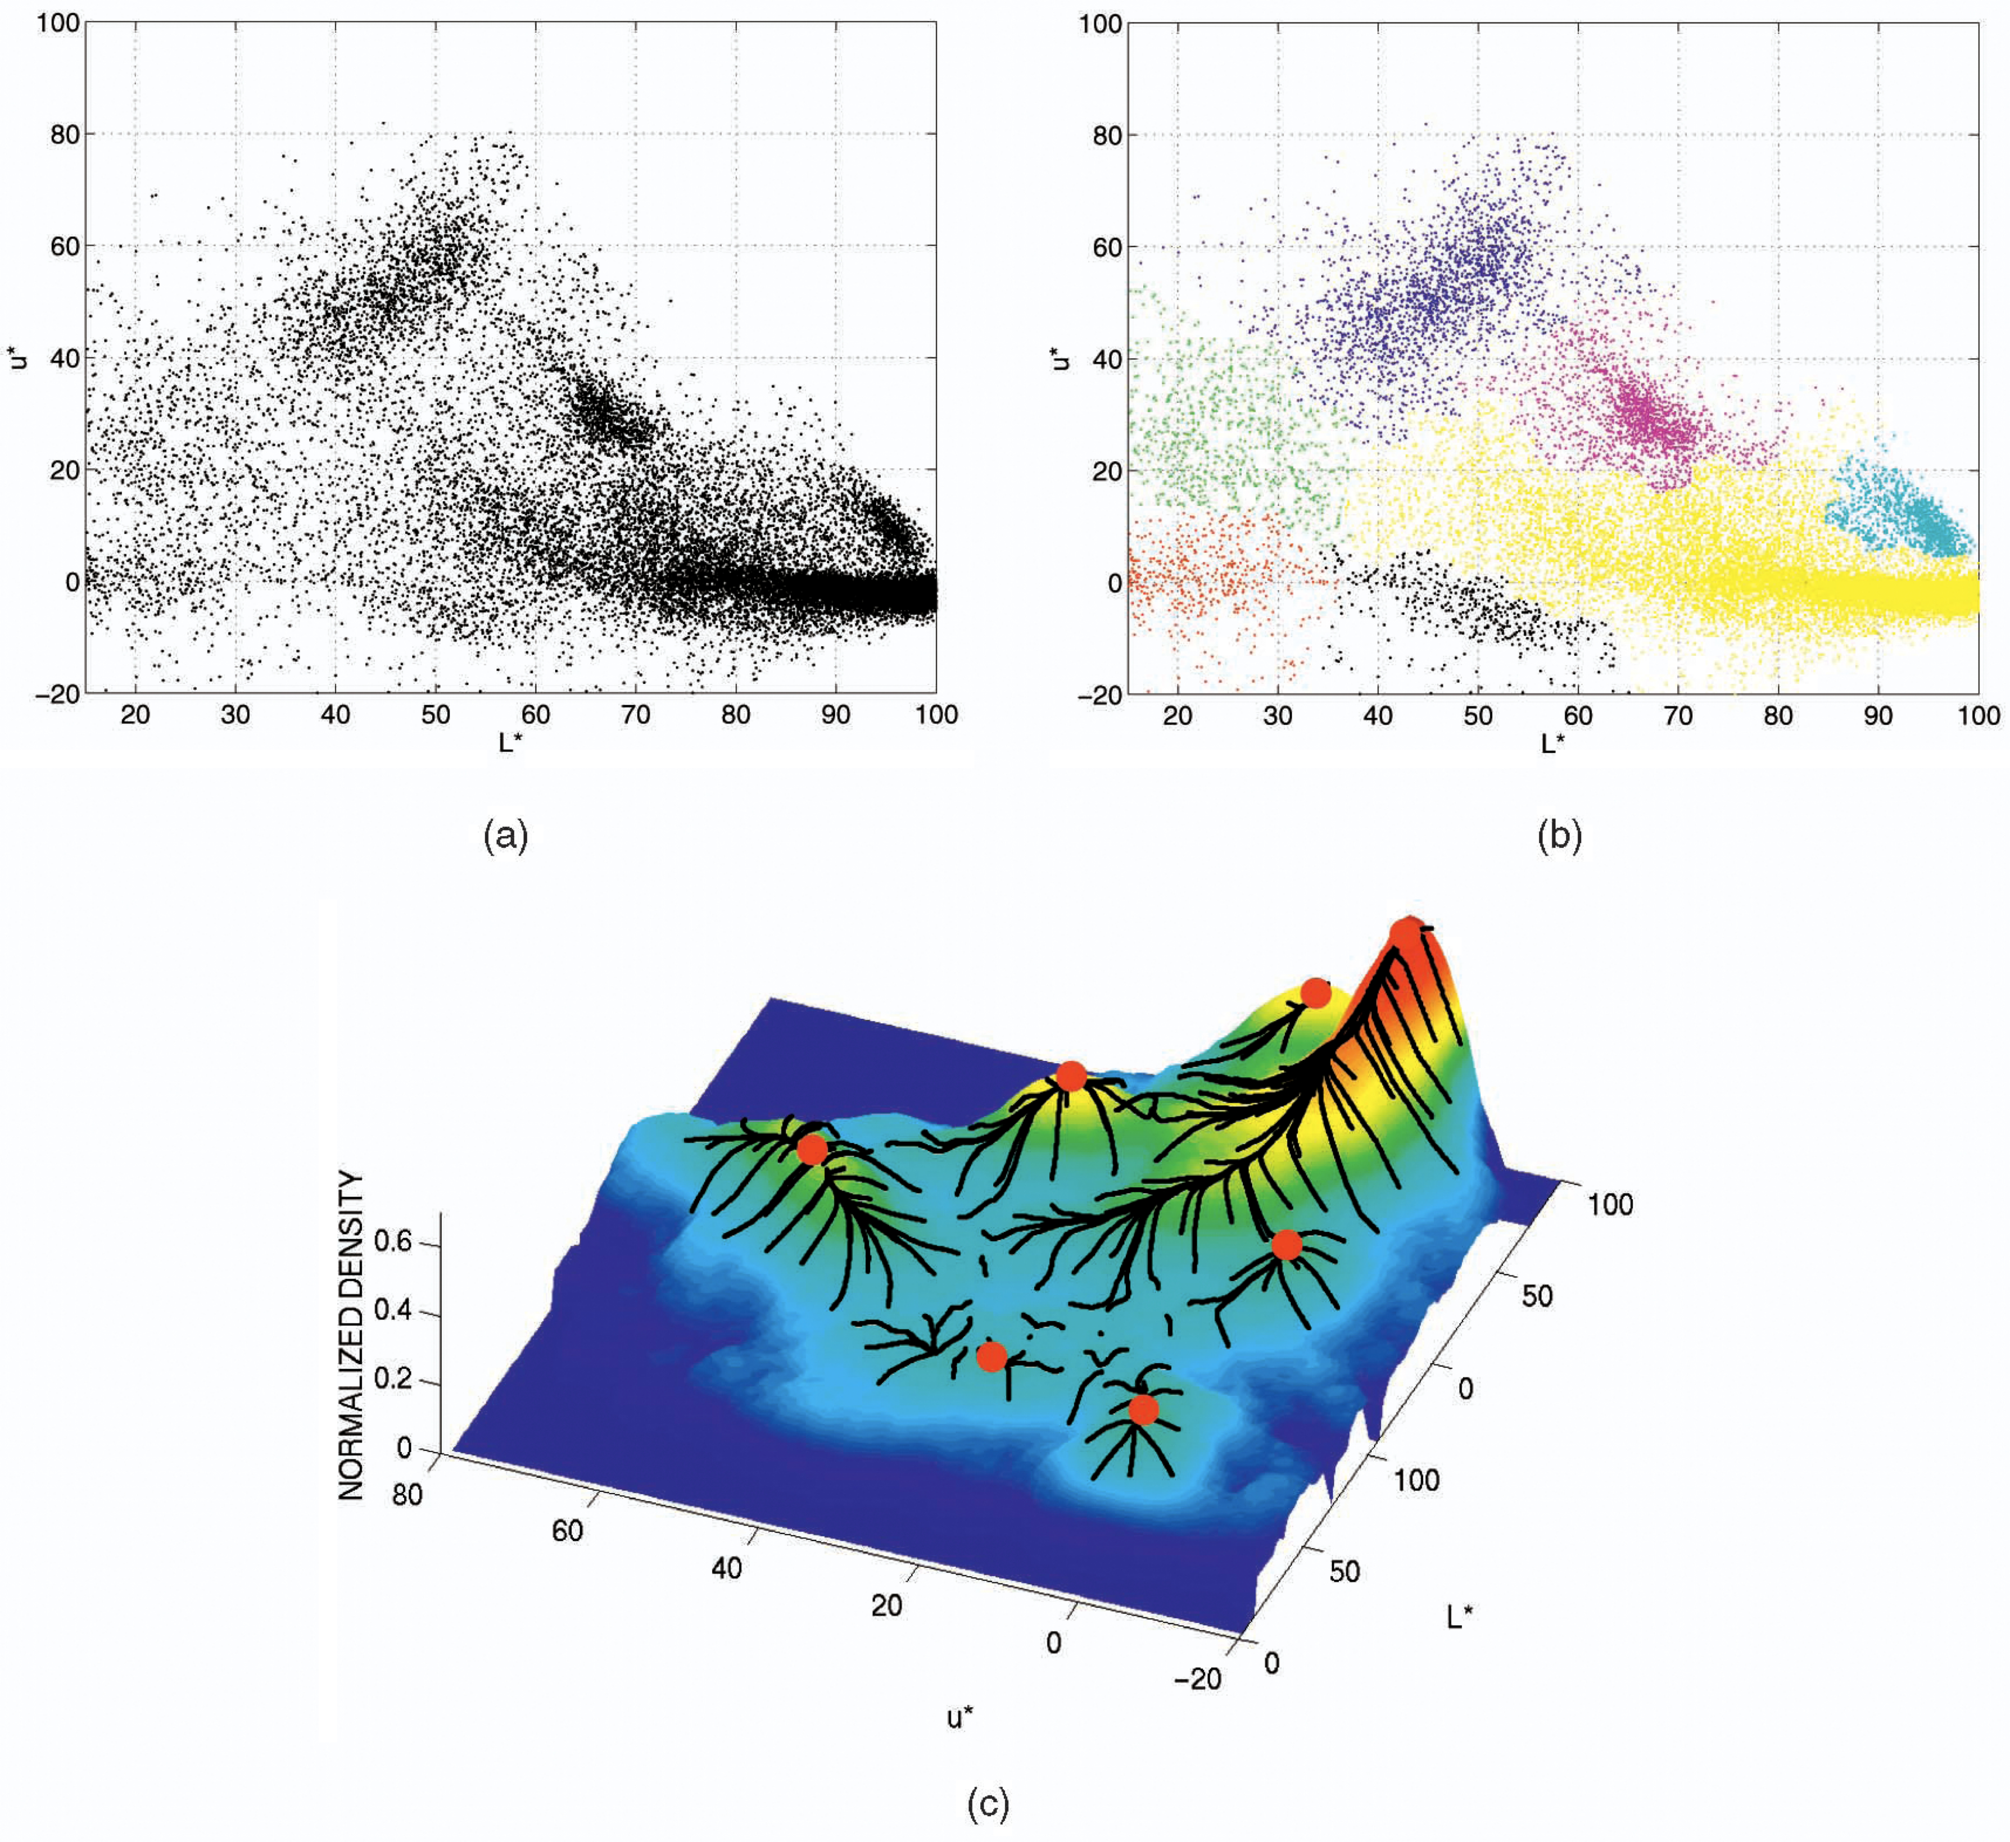
Mean-Shift Segmentation
Consider the different regions as having
(non-simple) color/space distributions
The image is in a sense a mixture model
How to cluster when the distributions aren’t simple ones?
Idea: smooth to approximate distributions
(i.e., kernel density estimation) and then
find modes in the distribution
All of the points that would “flow uphill” to a common mode are part of the same region
(like upside-down watersheds)

Slide 19
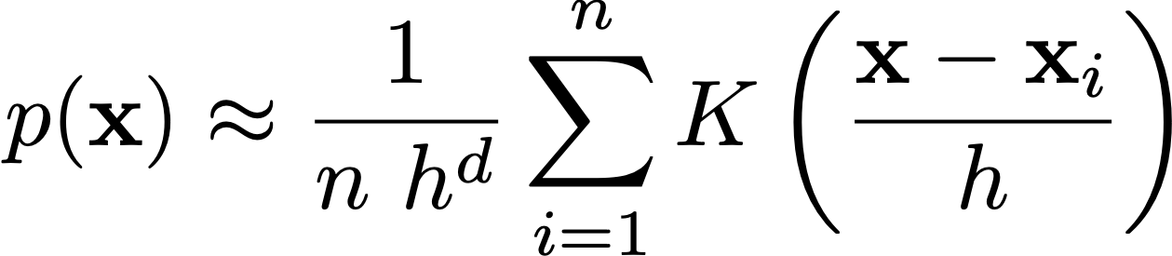
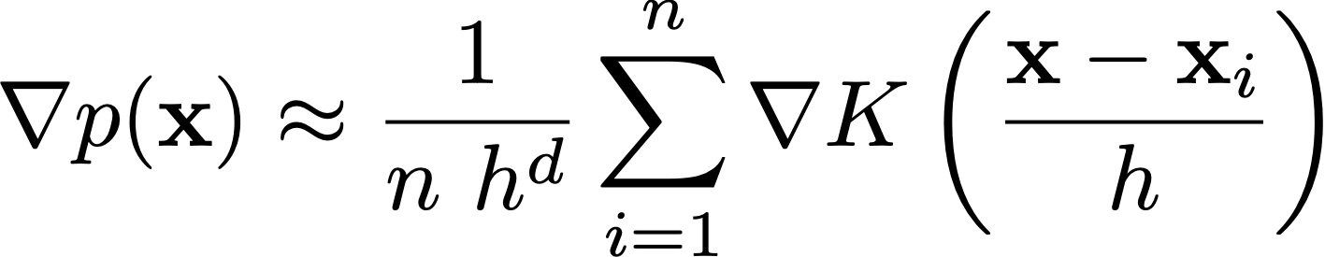
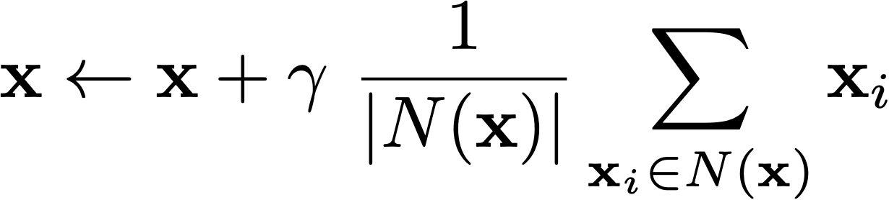
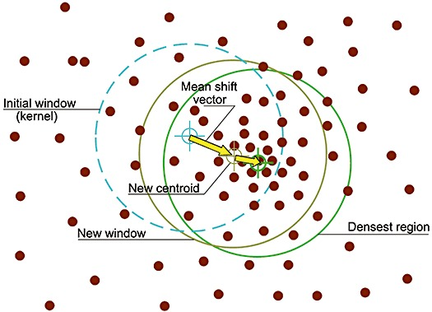
Mean-Shift Segmentation
Use gradient-ascent “hill climbing” of the local distribution to find modes
  Start with each pixel’s 5-D feature point
  Estimate gradient of local distribution
  Move incrementally “uphill”
Each evolving x moves towards each of the fixed original points proportional to the gradient of the kernel (decreases with the distance to those points)
The Epanechnikov kernel (triangle function) has the nice property of having a derivative of 1 within a fixed radius and 0 outside of it
Each point shifts towards the mean of all of the fixed original points within some radius of it!

Slide 20
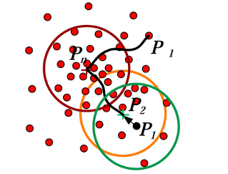
Mean-Shift Clustering
Mean-shift clustering is a powerful unsupervised data-clustering technique because it can adapt to all kinds of odd distributions
  Unsupervised data clustering in general
  Segmentation (“mean-shift segmentation”)
  Tracking (“mean-shift tracking”
You don’t need to know the number of clusters!

Slide 21
Mean-Shift Segmentation

Slide 22
Unsupervised Segmentation
All unsupervised methods have to balance extremes:
  Oversegmentation:
  lots of tiny regions
  Undersegmentation:
  regions not fine enough
Most have parameters to provide control:
  Image smoothing
  (watersheds)
  KDE smoothing
  (mean-shift)
  Subdivision / how many eigenvectors
  (spectral approaches)

Slide 23
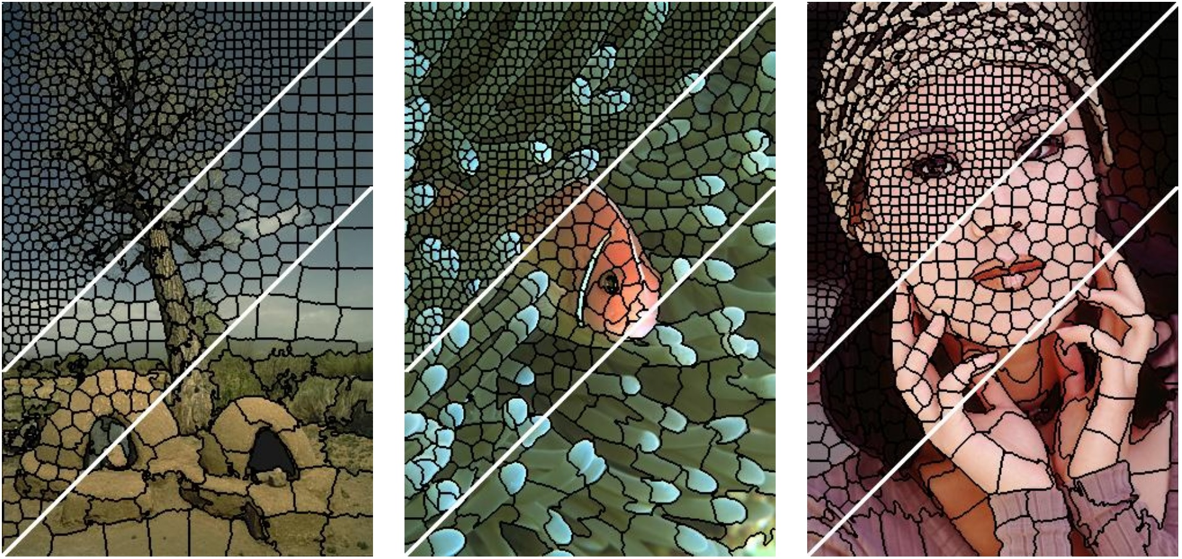
Superpixels
Idea: use unsupervised segmentation to severely over-segment the image
Each segmented region is nearly homogeneous
Treat these regions as “superpixels”
Employ other algorithms using these superpixels instead of basic pixels
  Example: much smaller graph to cut!
Can control size / number of superpixels
  More superpixels: more homogeneous regions
  Fewer superpixels: faster for other algorithms
Example of SLIC superpixels

Slide 24
Key Takeaways
Many segmentation algorithms are optimization between a likelihood and a prior
  Starting contour and smooth path through gradient.
  Proximity to seed pixel colors and boundary properties.
Many approaches match both color distributions and spatial locations pixels.
Pixel data can be clustered like any other data.
Algorithms have to balance between under and over segmenting the region.

